Slide 1
ARP Presentation
2324 PgCert | 17 January 2024 | Louise Stuart Trainor

Slide 2
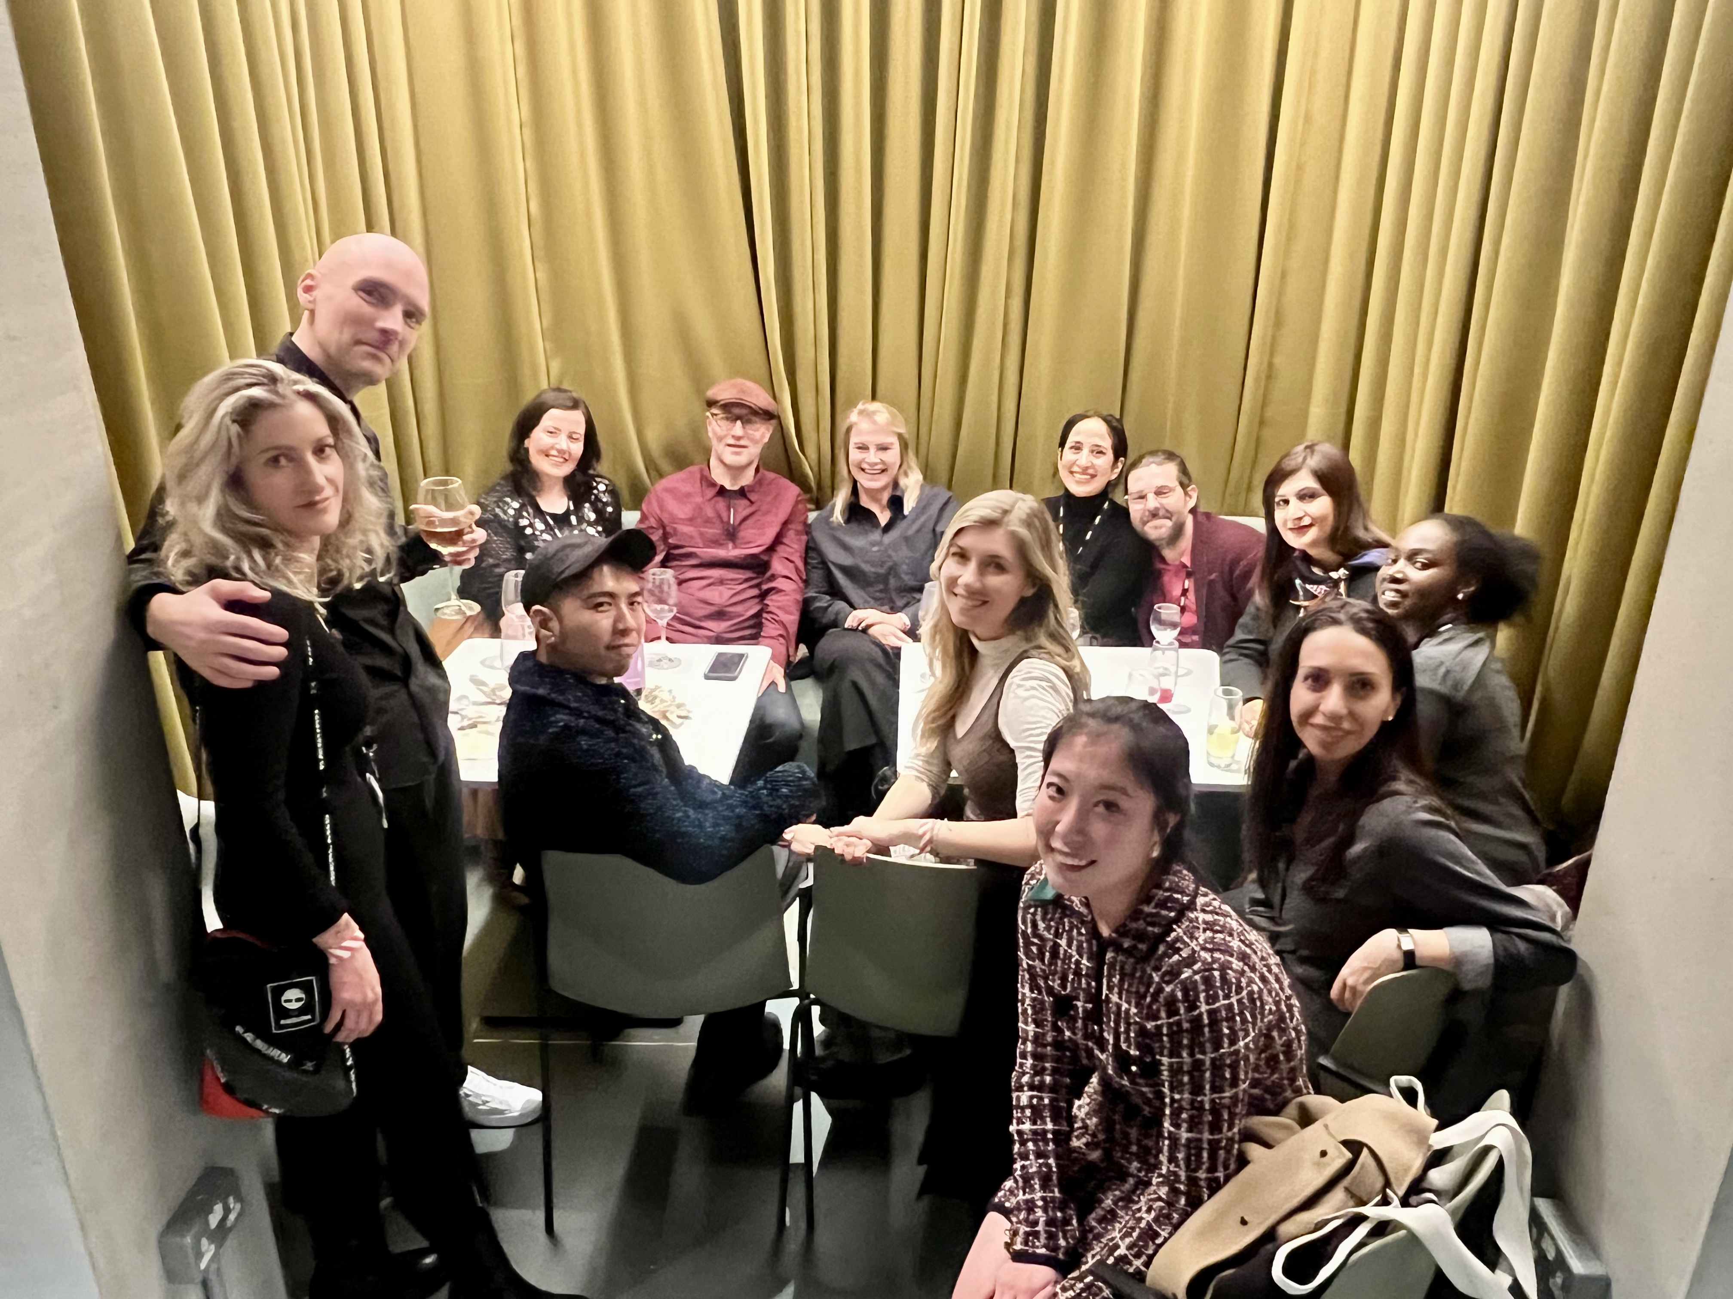
Professional context
Professional context
Since September 2023, new role Programme Director, Marketing & Branding (interim) Fashion Business School at LCF
Demanding role, less teaching, more people management
Previous fashion industry experience

Slide 3
Rationale for selecting the topic
Rationale
Within the IP unit, I developed an idea for a workshop to co-create what belonging looks like for Year 1 students, to help them settle in
Strayhorn (2016) says ‘belonging’ “refers to students’ perceived social support on campus, a feeling or sensation of connectedness, the experience of mattering or feeling cared about, accepted, respected, valued by, and important to the group or others on campus.”

Slide 4
Rationale for selecting the topic
Rationale
Greatest interaction with Year 2 students on BA Fashion Marketing and Consumer Behaviour
Can be quiet and disengaged in seminars
We acknowledge their challenges and maybe we can adapt
Research Question: Is it possible to adapt taught sessions to the overriding mood of the class?

Slide 5
Reflection on research methods used
Research Methods
Participatory Action Research was an exciting and uncertain journey
9x Year 2 students agreed to take part
3x meetings
1. Explain research question
2. Generate solutions
3. Review thematic analysis
Breaking the hierarchy

Slide 6
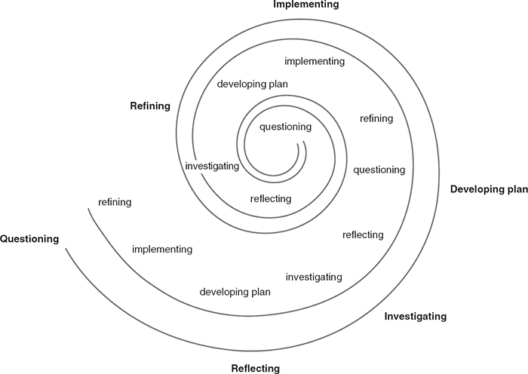
Reflection on research methods used
Research Methods
(McIntyre, 2008)

Slide 7
Reflection on research methods used
Research Methods
Students quickly dismissed the research question, doubting that mood-responsive teaching would improve their learning
Data generated went in multiple directions, sometimes completely off-topic
I was able to implement the students’ suggestions immediately, meaning we piloted the proposal sooner but without rigorous data analysis
The iterative process was rough and not aligned with the research timeline
“This led to doubts as to whether we were doing ‘proper research’ or whether we were doing ‘research properly’.” (Cook, 2009)

Slide 8
Summary of Project findings: reading
Findings
The Achievement Emotions Questionnaire is a comprehensive set of scales used to “measure students’ multiple achievement emotions” (Pekrun et al, 2011).
“to capture mood, researchers must develop methods that go beyond descriptions of individuals’ emotional states and are able to describe the collective emotional experience” (Stone & Thompson, 2014, p.312 cited in Canovi et al, 2019)
“I came to see that the circle of learning between student and teacher is a flow that has no clearly defined beginning… only when we came together and combined our resources did we fulfil our respective roles in this larger dance.” (Bache, 2008)

Slide 9
Summary of Project findings: primary research
Findings
Theme 1: Communication matters more than mood-responsive teaching
Students felt that moods would exist and change but that it didn’t matter. Instead they wanted a reset at the beginning of class.
“instead of like letting the emotion get to you so bad it's better to think of implementing activities that let you focus on another emotion that gets you ready for other activities.” – Student 2

Slide 10
Summary of Project findings: primary research
Findings
Theme 2: Students build confidence through reassurance from peers and tutors
“I think also asking a question I think to your peers, is maybe easier than to your lecturers because you know that there's no standard that you're meant to be like, there's no wrong answer with your peers because everyone is on the same level. There's no concern about feeling stupid.” – Student 9

Slide 11
Summary of Project findings: primary research
Findings
Theme 3: Specific and nuanced class interactions could improve engagement
“I think for me like the big the biggest change and most positive one has been mixing the groups again. I think that's been the best, like that's been the most helpful out of everything because like we spoke to each other like at the start of first year and we just didn’t see each other again.” – Student 4

Slide 12
Summary
Summary
Satisfied with the changes the project has made but there is more to do in terms of rigorous testing of implemented changes with the wider cohort
Listening and responding to the student voice is a form of social justice
Destabilising aspect of PAR should be embraced
Didn’t update research question
Rich data can be further mined for insights
Students who attend are happier but low-attending students have not been inspired to attend

Slide 13
References to relevant literature
ARP Presentation work-in-progress
Bache, C.M (2008) The Living Classroom: Teaching and Collective Consciousness. State University of NY Press: Albany.
Braun, V. & Clarke, V. (2012) 'Thematic analysis', in : H. Cooper, P. M. Camic, D. L. Long, A. T. Panter, D. Rindskopf, K. J. Sher (eds.) APA handbook of research methods in psychology, Vol. 2: Research designs: Quantitative, qualitative, neuropsychological, and biological. APA, (pp.57-71)
Canovi, A. G., Rajala, A., Kumpulainen, K., & Molinari, L. (2019). The Dynamics of Class Mood and Student Agency in Classroom Interactions. The Journal of Classroom Interaction, 54(1), 4–25. http://www.jstor.org/stable/45442287
Hascher, T. (2010). Learning and Emotion: Perspectives for Theory and Research. European Educational Research Journal, 9(1), 13-28. https://doi.org/10.2304/eerj.2010.9.1.13
Cook, T. (2009) ‘The purpose of mess in action research: building rigour though a messy turn’, Educational Action Research, 17:2, pp. 277-291. http://dx.doi.org/10.1080/09650790902914241
McIntyre, A. (2007) Participatory Action Research. Thousand Oaks: Sage. https://dx.doi.org/10.4135/9781483385679
Pekrun, R., Goetz, T., Frenzel, A.C., Barchfeld, P., Perry, R.P. (2011) Measuring emotions in students’ learning and performance: The Achievement Emotions Questionnaire (AEQ), Contemporary Educational Psychology, 36:1, pp. 36-48 https://doi.org/10.1016/j.cedpsych.2010.10.002.
Somekh, S. & Zeichner, K. (2009) Action research for educational reform: remodelling action research theories and practices in local contexts, Educational Action Research, 17:1, pp. 5-21, DOI: 10.1080/09650790802667402
Strayhorn, T.L. (2018) College Students' Sense of Belonging : A Key to Educational Success for All Students. Milton: Taylor & Francis Group.

