Slide 1
How can we innovate?
PGCert | 10 February 2023 | Microteach | Louise Stuart Trainor

Slide 2
What is Innovation? (noun)
Innovation Theories
“An innovation is an idea, practice, or object that is perceived as new.”
Rogers, 2003

Slide 3
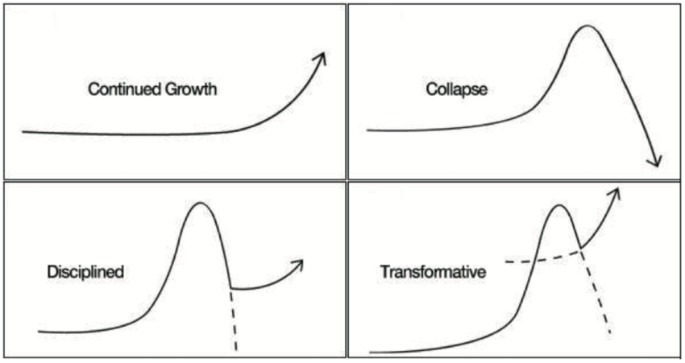
Jim Dator’s 4 Futures/Archetypes
Future Scenario Planning

Slide 4
Jim Dator’s 4 Futures/Archetypes
Future Scenario Planning
Dator’s Four Futures represent four different future contexts
Growth: a future in which “progress” has continued
Collapse: a future in which society as we know it has come apart
Discipline: a future in which order is deliberately coordinated or imposed
Transformation: a future in which a profound historical evolution has occurred
(Dator, 2019)

Slide 5
The Thing from the Future
Creative Game
Arc is the type of future and a time frame (Dator’s four futures framework)
Terrain is the context for the object, either a physical location or a domain of human activity
Object is the category of ‘future thing’ for which you will generate a description
Mood is how it feels to interact with that thing
(Candy, 2018)

Slide 6
Activity: The Thing from the Future
Creative Game
Imagine a creative story/product/scenario/service based on your three cards + object – make it as wild, strange and funny as possible!
Write it in words or draw something
Share with the group

Slide 7
Activity: The Thing from the Future
Creative Game
A creative prompt challenges us to imagine products and services in the future
An example using the following four cards: a continued growth (A) trajectory in the next decade, the context is a zoo (T), the product is a beverage (O) that imparts a sense of disgust (M).
In response one player proposed a product called ZooShooters, a hypothetical product from animal rights activist group PETA. This drink, when imbibed, gives one the experience of the suffering of a caged animal.

Slide 8
Disruptive Innovation
Innovation Theories
“Disruption” describes a process whereby a smaller company with fewer resources is able to successfully challenge established incumbent businesses (with sizeable share of the market).
Disruption theory differentiates disruptive innovations from what are called “sustaining innovations.” The latter make good products better in the eyes of an incumbent’s existing customers: the fifth blade in a razor, the clearer TV picture, better mobile phone reception.
Christensen, C.M., Raynor, M. and McDonald, R. (2015)

Slide 9
Disruptive Innovation
Innovation Theories
Is your innovation:
disruptive : challenges existing norms
OR
sustaining : makes good products or services better

Slide 10
References
Essential Information
Rogers, E.M. (2003) Diffusion of Innovations. New York: Free Press.
Dator, J. (2009). Alternative futures at the Manoa School. Journal of Futures Studies, 14(2), 1–18.
Candy, S. (2018) Transforming the Future: Anticipation in the 21st Century. Routledge. Chapter 6. https://www.taylorfrancis.com/chapters/oa-edit/10.4324/9781351048002-7/gaming-futures-literacy-stuart-candy
Christensen, C.M., Raynor, M. and McDonald, R. (2015) ‘What is disruptive innovation?’, Harvard Business Review, 93(12), pp. 44–53.

